Slide 1
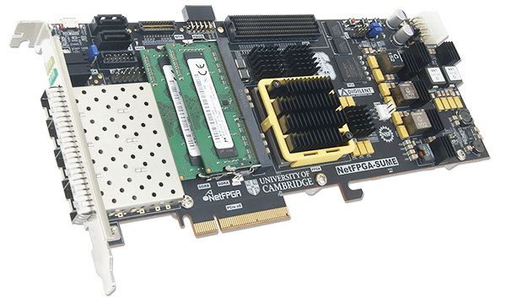
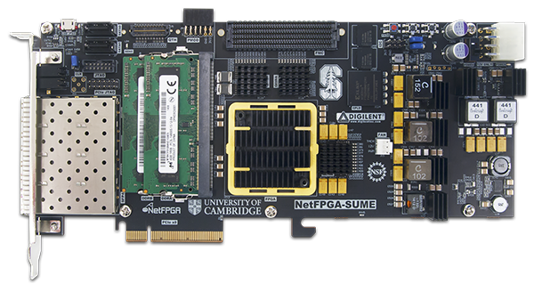
NetFPGA SUME
High-performance and high-density networking design.
Why SUME?
The NetFPGA-SUME board is the ideal platform for high-performance and high
density networking design. A collaborative effort between Digilent, the University of
Cambridge and Stanford University, the NetFPGA-SUME has everything you need
to conduct cutting edge research and development of state-of-the-art networking
systems.
The NetFPGA-SUME is an amazingly advanced board that features one of the
largest and most complex FPGA’s ever produced, a Xilinx Virtex-7 690T supporting
thirty 13.1 GHz GTH transceivers.Four SFP+ 10Gb/s ports, five independent high
speed memory banks built from both 500MHzQDRII+ & 1866MT/s DDR3 SoDIMM
devices, and an eight-lane third generation PCIe offer incredible throughput and
can sustain a large number of high-speed data streams to the FPGA fabric and
memory devices. Other features include the presentation of twenty transceivers in
total on FMC and QTH expansion connectors, and SATA ports. This board can
manipulate and process data on-board, or stream it over the 8x Gen.3 PCIe
interface and the expansion interfaces
General Information
Part Number | 410-301P-KIT
List Price | $9,750
Academic Price | $4,995
Distributor Discount | Non-academic - 20% Academic - 15%

Slide 2
NetFPGA SUME
High-performance and high-density networking design.
Board Features:
Xilinx Virtex-7 XC7V690T FFG1761-3
Four SFP+ interface (4 RocketIO GTH transceivers) supporting 10Gbps
PCI-E Gen3 x8 (8Gbps/lane)
QTH Connector (8 RocketIO GTH transceivers)
Two SATA-III ports
One HPC FMC Connector (10 RocketIO GTH transceivers)
Three x36 72Mbits QDR II SRAM (CY7C25652KV18-500BZC)
Two 4GB DDR3 SODIMM (MT8KTF51264Hz-1G9E1)
MicroUSB Connector for JTAG programming and debugging (shared with UART interface)
Two 512Mbits Micron StrataFlash (PC28F512G18A)
Xilinx CPLD XC2C512 for FPGA configuration
User LEDs and Push Buttons
General Information
Part Number | 410-301P-KIT
List Price | $9,750
Academic Price | $4,995
Distributor Discount | Non-academic - 20% Academic - 15%

Slide 3
NetFPGA SUME
High-performance and high-density networking design.
Resources
This board is supported by a large collection of free IP blocks available at www.netfpga.org
Need more information? Please visit the NetFPGA-SUME Wiki Site.
Pictures
https://www.flickr.com/photos/127815101@N07/15836738192/in/album-72157648969670909/
https://www.flickr.com/photos/127815101@N07/15215749963/in/album-72157648969670909/
Family products
General Information
Part Number | 410-301P-KIT
List Price | $9,750
Academic Price | $4,995
Distributor Discount | Non-academic - 20% Academic - 15%
NetFPGA 1G CML (P/N: 6015-410-001P-KIT)
http://www.digilentinc.com/Products/Detail.cfm?NavPath=2,400,1228&Prod=NETFPGA-1G-CML

